Slide 1
Horizon Community College

Slide 2
Project Summary
Design and implementation of a complete enterprise-level network
One main campus and two branch campuses
Cisco Packet Tracer used for layout, wiring, IP configuration, and testing
Focus: Security, scalability, internet connectivity, and VLAN segmentation

Slide 3
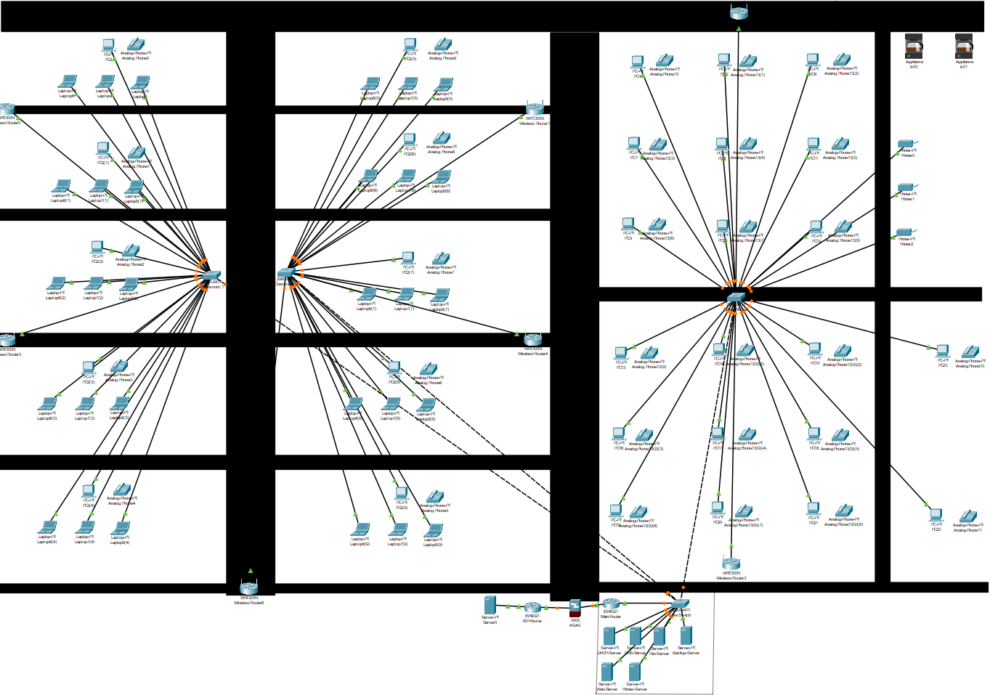
Main Campus
10 Classrooms (20 student stations each, shown as 3 PCs for clarity)
20 Offices (1 PC and phone each)
1 instructor station per classroom
Central core switch and firewall
Notes:
The main campus is fully wired with core-switch redundancy and structured cabling. Each switch connects multiple rooms, and everything routes back to the firewall and router infrastructure.

Slide 4
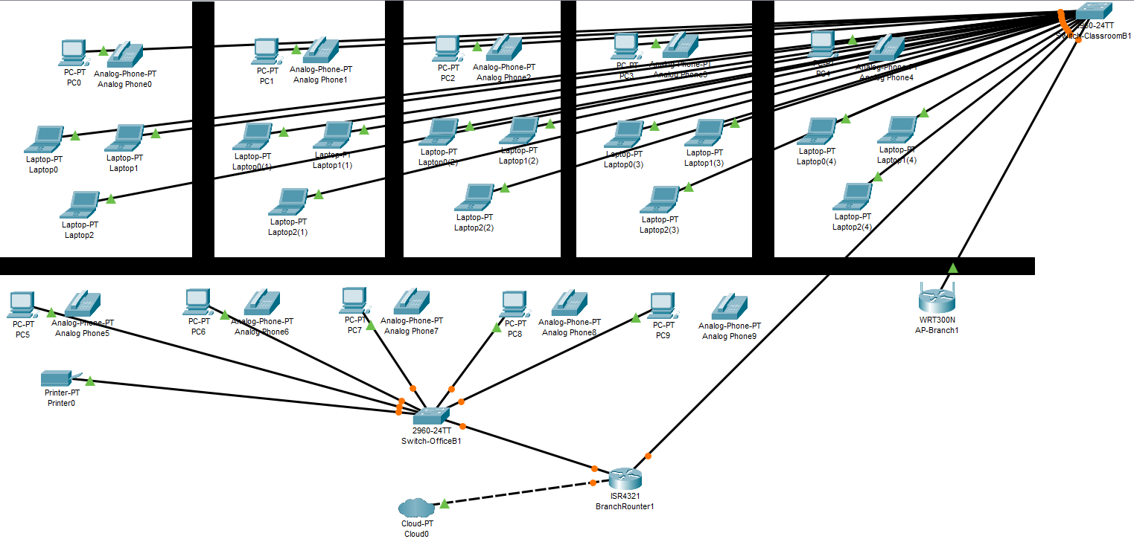
Branch Campus
5 Classrooms and 5 Offices
ISR Router, and ASA Firewall
Notes:
There are 2 branch campuses this is a screenshot of branch 1 there are mirrored

Slide 5
Logical Network Topology
Core Router (Main campus) handles inter-VLAN routing
Access switches per room connected with trunk links
ASA 5505 firewall filters outbound/inbound traffic

Slide 6
VLAN Segmentation
VLAN 10 – Admin: 192.168.10.0/24
VLAN 20 – Students: 192.168.20.0/24
VLAN 30 – Instructors: 192.168.30.0/24
VLAN 40 – Servers: 192.168.40.0/24
VLAN 50 – Printers: 192.168.50.0/24
VLAN 60 – Wireless: 192.168.60.0/24
VLAN 99 – Management: 192.168.99.0/24
Notes:
Each group has a dedicated VLAN. This isolates traffic so students can't interact directly with servers or staff. VLAN 99 is used for switch management.

Slide 7
Security Features
VLANs isolate traffic between student, office, server, and guest devices
ACLs prevent student-to-server/printing communication
Sticky MAC and port security on access ports
WPA2-Enterprise for staff Wi-Fi, WPA2-PSK for guest VLAN
Notes:
Sticky MAC locks a specific device's MAC address to a switch port. If another MAC appears, the port shuts down, preventing unauthorized device swaps. ACLs further block traffic between sensitive VLANs. Wi-Fi access is separated for guests and employees.

Slide 8
Conclusion
Secure, scalable, and redundant network for education
Simulated real-world deployment with full IP segmentation
Easily expandable for new campuses or technologies

